Slide 1

“VFF” & “MBM” MTP project
VFF & MBM overall presentation
Marco Sacco
Model-Based and Factory Framework for Manufacturing
Holistic, extensible, scalable and standard Virtual Factory Framework

Slide 2

VFF project
Marco Sacco
DURATION: 42 months
STARTING DATE: 1st September 2009
PROJECT N°: FP7-NMP-2008-3.4-1; 228595
STRATEGIC OBJECTIVE: Theme 4 – NMP – Nanosciences, Nanotechnologies, Materials and new Production Technologies
BUDGET: 12.075.455€
COORDINATOR: ITIA-CNR

Slide 3
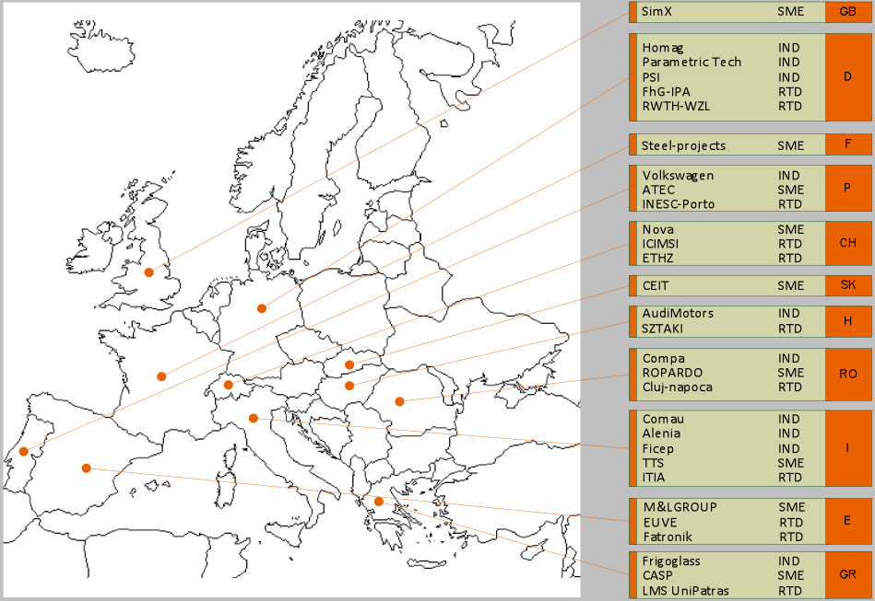
VFF Consortium – 30 partners
Marco Sacco

Slide 4
Partners Involved in the MTP
Marco Sacco
The EU-CH project is a self standing project with its own workflow. An effective exchange of knowledge and integration will be assured by the Interregional project management. Three partners already has resources allocated for the task: ITIA, SZTAKI and I-CIMSI-SUPSI)
USA: EU:
Rockwell Collins IND ITIA-CNR (I) R&D
SZTAKI (H) R&D
Mexico: SZTAKI (H) R&D
Tecnologico de Monterrey R&D ROPARDO (RO) SME
COMPA (RO) IND
COMAU (I) IND
CH:
I-CIMSI-SUPSI R&D VDC (D) Network
ETHZ R&D VTT (Fin) R&D

Slide 5
Project Objectives & Pilots
Marco Sacco
Objectives:
Model-based visualization, including immersive 3D viewing, which integrates product modeling for manufacturing analysis and analytical outputs
Model-based simulation of factory floor and enterprise operations, integrated with linear optimization process modeling
Factory Framework adoption for improving the interoperability of systems
Solving industry-based problem with return on investment
Pilots:
Advanced visualization for automotive manufacturing and power train
Advanced visualization of electronic circuit board assemblies and higher level electro-mechanical assemblies

Slide 6
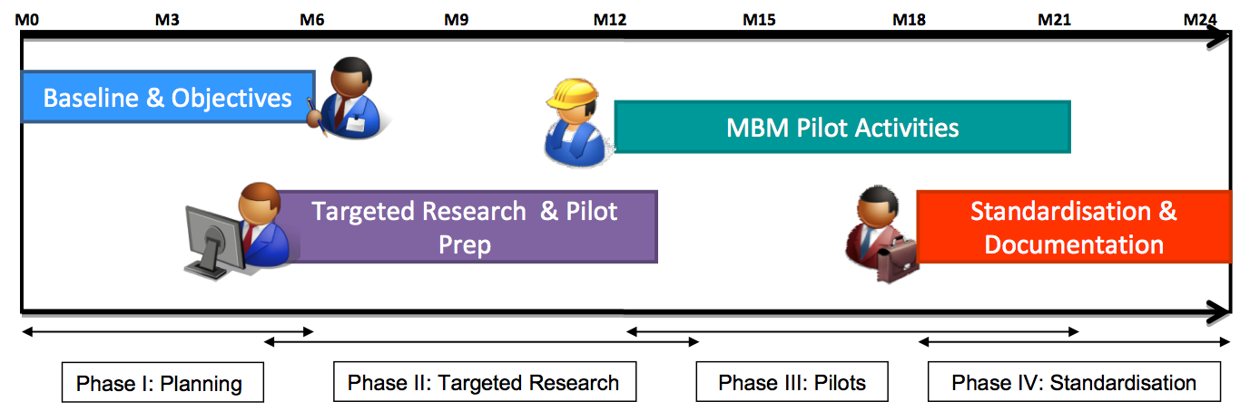
Project Planning
Marco Sacco
Leader:
USA EU MEXICO USA

Slide 7
VFF

Slide 8
VFF
1
Reference
data-model

Slide 9
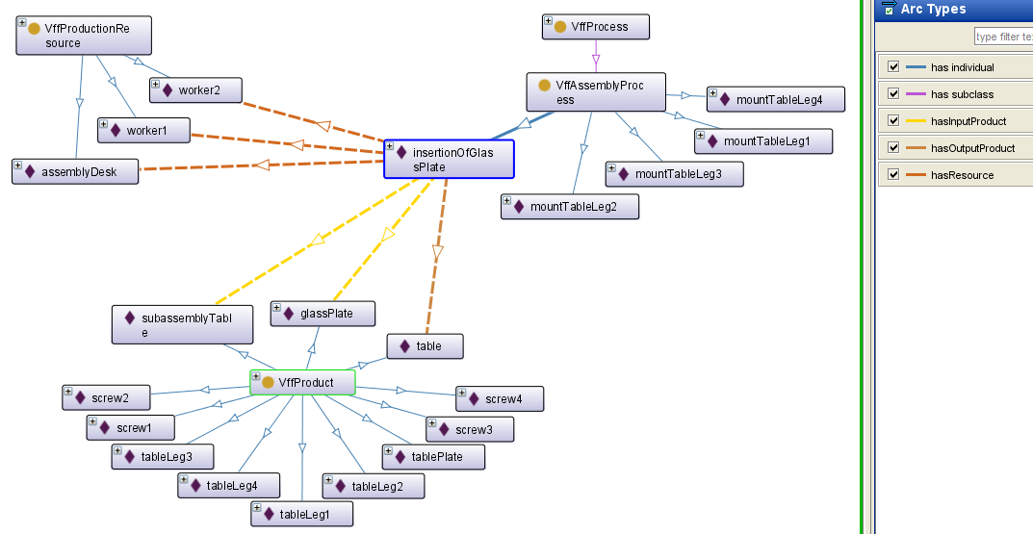
Process
Resource
Product

Slide 11
VFF
1
Reference
data-model

Slide 12
access control selective data query versioning open interface
2
Virtual factory manager
VFF
1
Reference
data-model

Slide 13
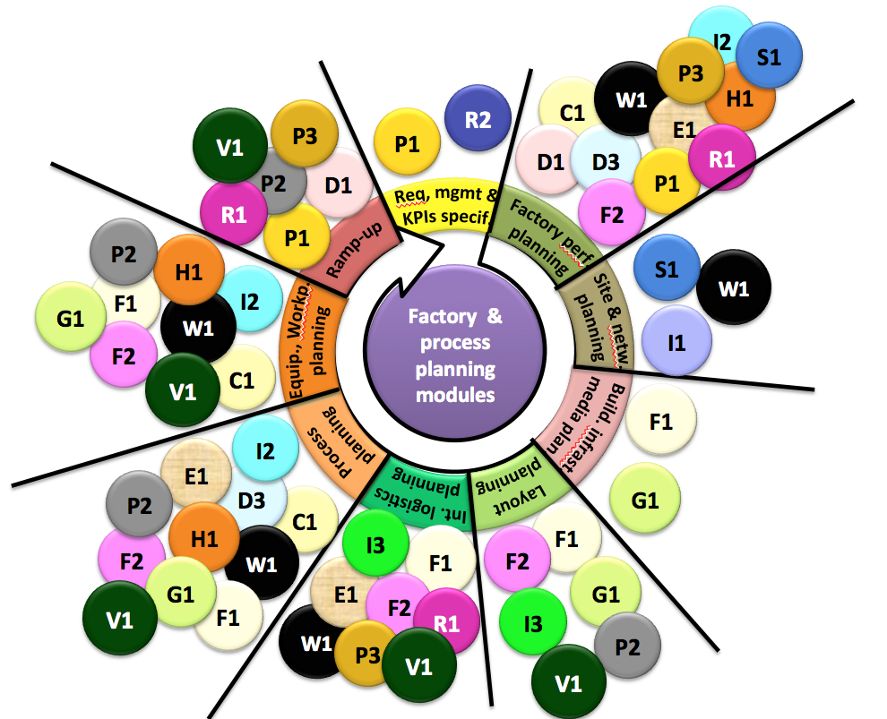
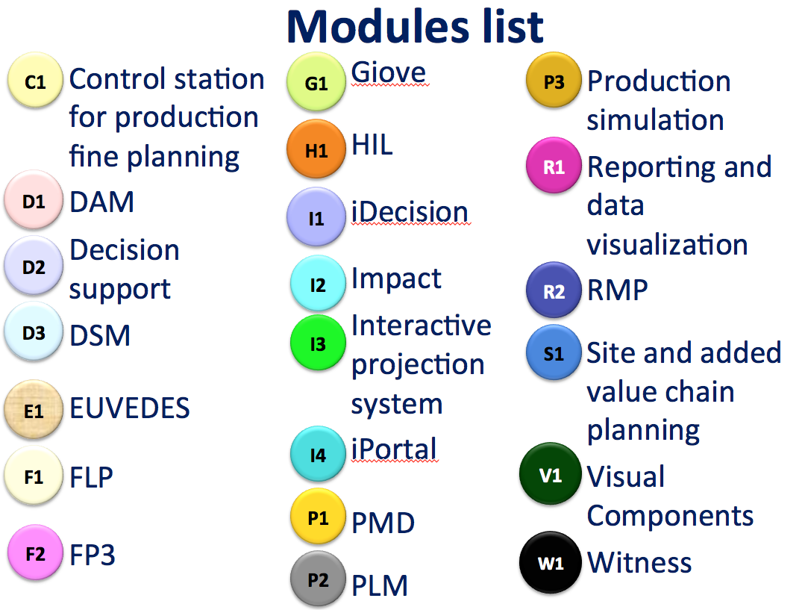
…
Visual Components
Witness
GIOVE
FLP
3
Decoupled
modules
…
access control selective data query versioning open interface
2
Virtual factory manager
VFF
1
Reference
data-model

Slide 14

…
Visual Components
Witness
GIOVE
FLP
3
Decoupled
modules
…
access control selective data query versioning open interface
2
Virtual factory manager
VFF
1
Reference
data-model
4
Knowledge
base

Slide 15
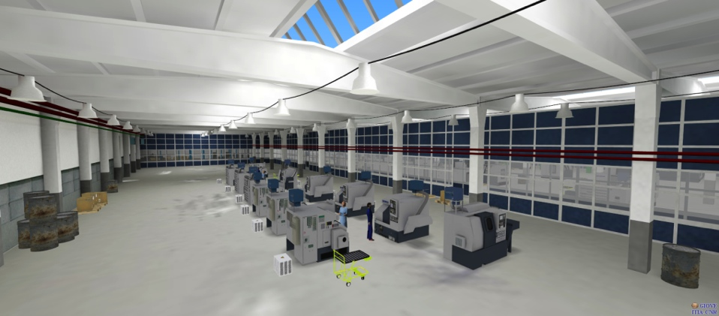
Virtual Factory
…
Visual Components
Witness
GIOVE
FLP
3
Decoupled
modules
…
access control selective data query versioning open interface
2
Virtual factory manager
VFF
1
Reference
data-model
4
Knowledge
base

Slide 16
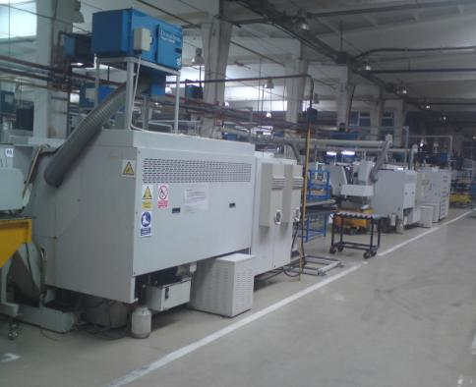
Real Factory
Virtual Factory
…
Visual Components
Witness
GIOVE
FLP
3
Decoupled
modules
…
access control selective data query versioning open interface
2
Virtual factory manager
VFF
1
Reference
data-model
4
Knowledge
base

Slide 17


Slide 18
VFF project: contact info
Marco Sacco
Web site: www.vff-project.eu
  Project brochure
  Newsletter: #1 and #2
Social Network:
  Twitter (www.twitter.com) VirtualFactory
  Slideshare (www.slideshare.com)
SIG: http://vff-sig.inescporto.pt/
Coordinator: Marco Sacco
  Mail: marco.sacco@itia.cnr.it
  Skype: marco_s1368

